Slide 1

CYBER SECURITY
Presented by
Afna Ayshu Jaffin
S2 CSE A
Roll.No:05

Slide 2

CONTENTS
Introduction
Hackers
How to prevent hacking
Malware
Conclusion
Need of Cyber Security

Slide 3

INTRODUCTION
The term cyber security is used to refer to the security offered through online services to protect your online information
With an increasing amount of people getting connected to the Internet, security threats that cause massive harms are increasing.

Slide 4
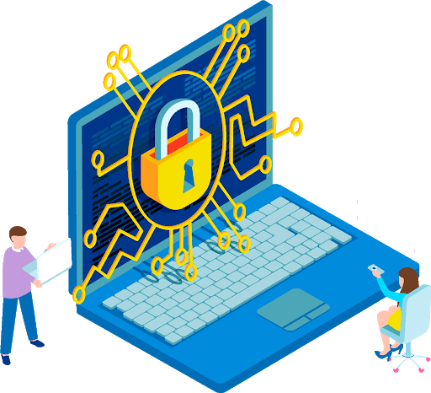
NEED OF CYBER SECURITY
Cyber security is necessary since it
helps in securing data from
threats such as data theft or misuse,
also safeguards your system from viruses.

Slide 5
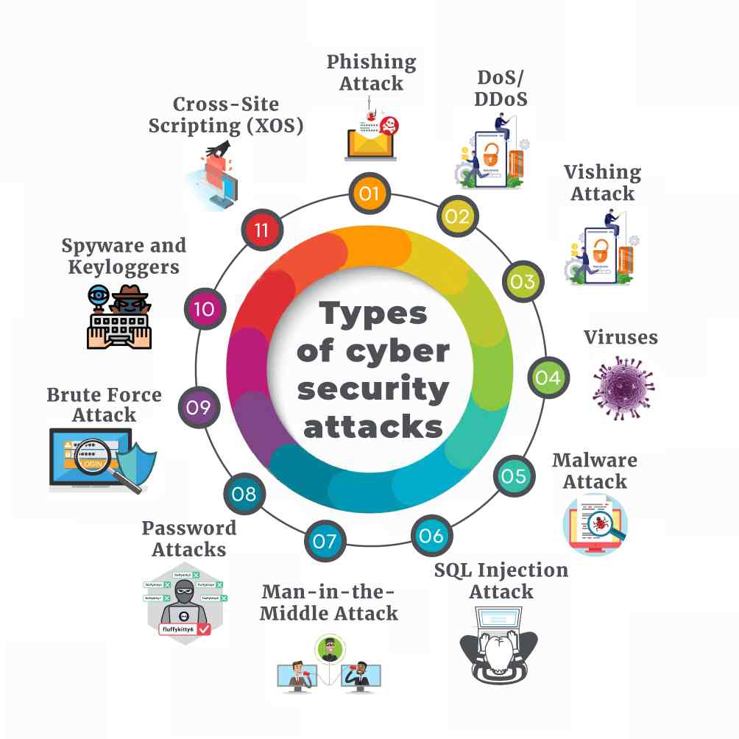
MAJOR SECURITY PROBLEMS
Virus
Hacker
Malware
Trojan horses
Password cracking

Slide 6
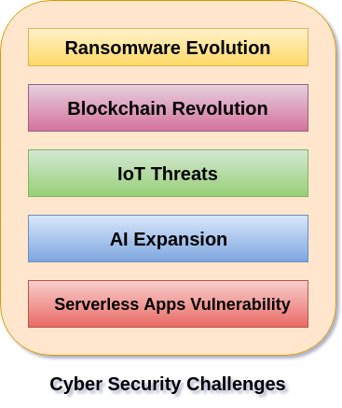

Slide 7

HACKERS
In common a hacker is a person who breaks into computers, usually by gaining access to administrative controls.

Slide 8
TYPES OF HACKERS
White hat hacker
Grey hat hacker
Black hat hacker

Slide 9

HOW TO PREVENT HACKING
Its impossible to prevent hacking , however effective security controls
including strong passwords and use of firewalls can help.

Slide 10
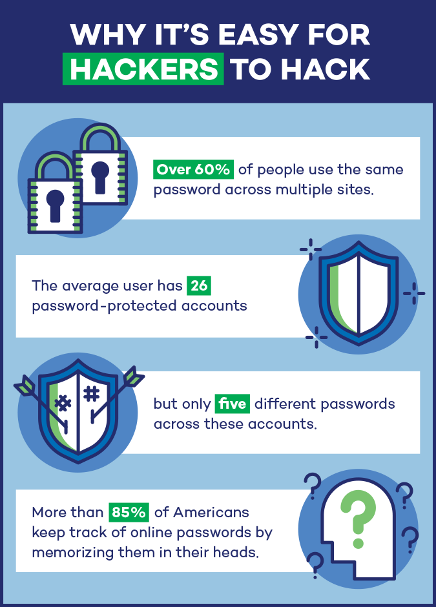

Slide 11
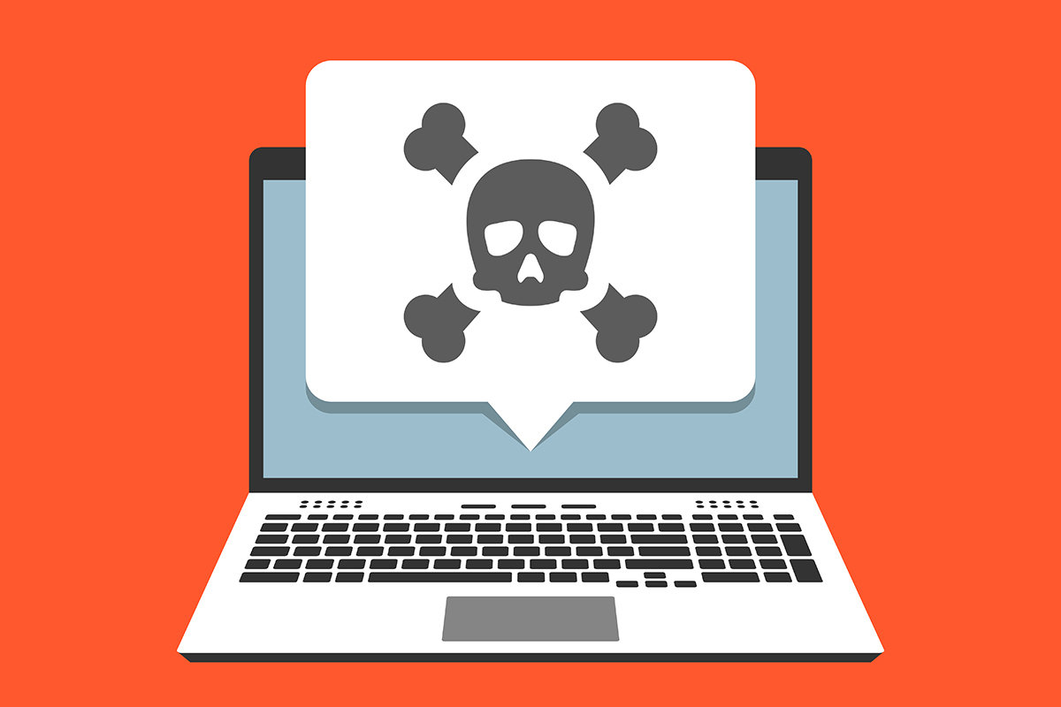
MALWARE
The word “Malware” comes from the term MALicious softWARE.
Malware is any software that infects and damages
a computer system without the owner’s
knowledge or permission.

Slide 12
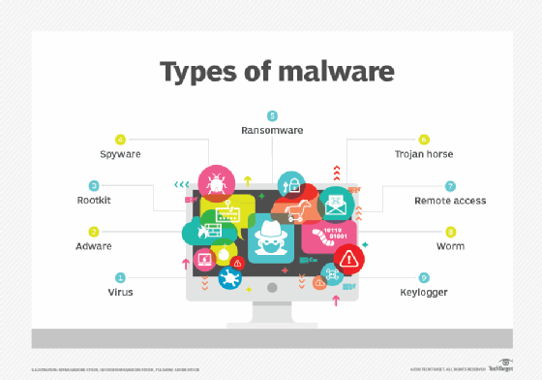

Slide 13
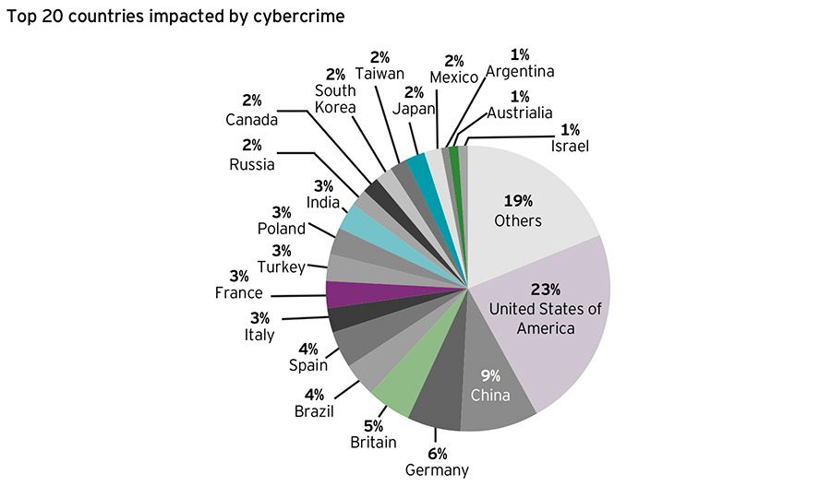

Slide 14
CONCLUSION
I hope that my audience got an overview
on cyber security and its importance .
I would like conclude by saying that cyber security is a necessity in today’s world so we should do our part regarding this matter to ensure our as well as others security.

Slide 15


